Slide 1
Python More Variables
Lesson B.4

Slide 2
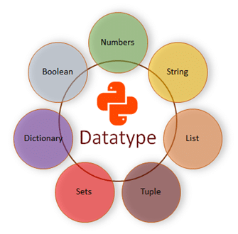
Python Data Types
Programs need to deal with more than just simple numbers to be useful.
Python programs can handle a number of different data types and variables:
int - For whole numbers
float - For decimal numbers
bool - For True / False decisions
str - For text messages
list - For collections of related items
Try the "type()" commands listed in the sample program on the right
Sample Program:
print(type(2))
print(type(2.0))
print(type(True))
print(type("Hello"))
print(type([2,3]))

Slide 3
Float Data Type
Decimal number variable values

Slide 4
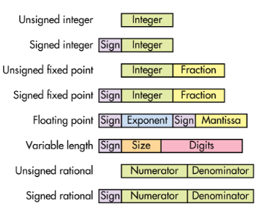
Float Variable Type
Computers handle numbers in different ways.
Integer Numbers (type int)
Used for whole numbers
Have a limited size / range
0 to 65,535 or
-32,768 to +32,767
Processing is very fast and efficient
Floating Point Numbers (type float)
Used for numbers with decimal points
Have an unlimited size
Processing is slower and less efficient
Sample Program:
myAnswer = 40*2
print("My answer is type:", type(myAnswer))
print("My answer is value:", myAnswer)
myAnswer = 40/2
print("My answer is type:", type(myAnswer))
print("My answer is value:", myAnswer)

Slide 5
Float & Int Operators
Sometimes it is necessary to convert floats and integers
Operator "int()"
Converts the value to type integer
Rounds the value if necesary
Operator "float()"
Converts the value to a floating point
Does not change the value
Sample Program:
myFloat = 5/2
print("My Float is:",myFloat)
myInt = int(myFloat)
print("My Int is:",myInt)
myFloat2 = float(myInt)
print("My Float2 is:",myFloat)

Slide 6
Modulus Operator "%"
Division using integers gives an answer in two parts:
Quotient – The result
Remainder – What is left over
The "%" operator is special in programming
It does division and returns the remainder
Note: The remainder can be a float
Sample Program:
myQuotient = int(10/3)
myRemainder = 10%3
print("For 10/3 the quotient is:",myQuotient)
print("For 10/3 the remainder is:",myRemainder)

Slide 7
Floats & Python Control
Program control works the same way for floats and integers
IF statements work the same
WHILE loops work the same
Conditional statements may use a mix of floats and integers
However, results may sometimes be unexpected
Sample Program:
if (1 == 1.0):
print("They are equal!")
else:
print("They are different!")

Slide 8
Boolean Data Type
True / False variable values

Slide 9

Boolean Variable Type
Stores the result of a logical statement (condition)
A statement that returns a True or False answer
A Boolean variable has a value of True or False only
Logical Statements Include:
Equality ( == or != )
Comparison ( >, <, >=, <=)
Logical Operators ( and, or, xor, not)
Boolean Variables are used to control
IF statements and WHILE loops
Sample Program:
myGrade = 75
didPass = (myGrade >= 50)
print("I passed is:",didPass)

Slide 10
Logical AND Operator
Is True only if both StatementA AND StatementB are True
A | B | A and B
True | True | True
True | False | False
False | True | False
False | False | False
Sample Program:
myGrade = 75
isLevel3 = (myGrade > 70) and (myGrade < 80)
print("I have a Level 3 is:",isLevel3)

Slide 11
Logical OR Operator
Is True only if either StatementA OR StatementB are True
A | B | A or B
True | True | True
True | False | True
False | True | True
False | False | False
Sample Program:
myGrade = 75
notValid = (myGrade > 100) or (myGrade < 0)
print("Grade is not valid is:",notValid)

Slide 12
Logical XOR Operator
Is True only if either StatementA XOR StatementB are False
But NOT both True or False
Note: Python uses != to mean XOR
A | B | A xor B
True | True | False
True | False | True
False | True | True
False | False | False
Sample Program:
myGrade = 75
notValid = (myGrade < 100) != (myGrade > 0)
print("Grade is not valid is:",notValid)
NOTE: XOR stands for Exclusive OR

Slide 13
Logical NOT Operator
Is the Opposite of StatementA
Sample Program:
myGrade = 75
isValid = not( (myGrade > 100) or (myGrade < 0) )
print("Grade is valid is:", isValid)
A | not A
True | False
False | True

Slide 14
Booleans & Python Control
Booleans can be used to control:
IF statements
WHILE loops
Boolean variables can be used in place of conditional statements
Boolean variables can also be used in combination with conditional statements
Sample Program:
myGrade = 75
didPass = (myGrade >= 50)
if (didPass) :
print("Great, you passed!")
else :
print("Too bad, see you next year.")
if (didPass and (myGrade >= 85)) :
print("You also got honours!")

Slide 15
Loops & Break Statement
Sometimes you want to check a condition near the end of a WHILE loop
The BREAK statement
Stops the loop early (i.e. Breaks out of the loop)
Can be used anywhere in the loop
Can be used anytime in the loop
Sample Program:
count = 1
while (True) :
print("Count is",count)
if (count >= 10) :
break
else :
count = count + 1

Slide 16
String Data Type
Text and character variable values

Slide 18
String Variable Type
While
break

Slide 19
Booleans & Python Control

Slide 20
String Operators

Slide 21
Strings & Python Control

Slide 22
List Variable Type

Slide 23
List Operators

Slide 24
Lists & Python Control

Slide 26
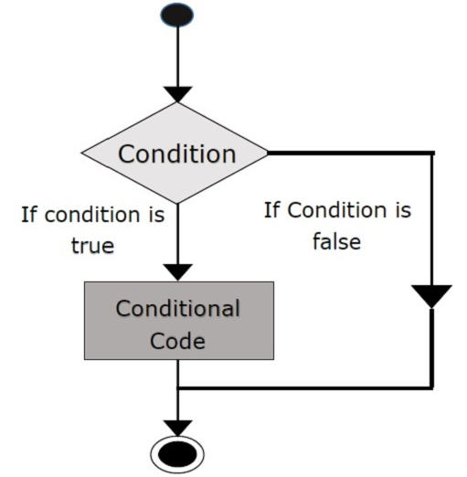
IF Statement Control
Computer Programs
Need to make decisions
Do different things based on those decisions
The "if" statement is used to provide decision control in computer programs.
Note the Syntax:
Lowercase if
Ending colon :
Sample Program:
classSize = int(input("How many students:"))
if (classSize > 30) :
extra = classSize - 30
print("You need %d more computers" % extra)
print("Let's start our lesson")

Slide 27
Indentation & Code Blocks
The result of the if statement is a Code Block
A code block is an optional part of the program
The code is only executed if certain conditions occur
A code block is indented
May contain one or more lines of code
All lines at the same level of indentation are part of the same code block
Note the Syntax:
Indentation Level
Style Convention is 4 spaces or 1 tab
Sample Program:
classSize = int(input("How many students:"))
if (classSize > 30) :
extra = classSize - 30
print("You need %d more computers" % extra)
print("Let's start our lesson")

Slide 28
Conditional Expressions
The question asked by an if statement is a Conditional Expression
May be a mathematical comparison
May be a true or false (Boolean) expression
Types of Conditional Expressions
Mathematical Comparisons >, <, >=, <=, ==, !=
Boolean Expressions and, or, not, xor, true, false
Note the Syntax:
Enclosed in brackets
May compare variables
Sample Program:
classSize = int(input("How many students:"))
if (classSize > 30) :
extra = classSize - 30
print("You need %d more computers" % extra)
print("Let's start our lesson")

Slide 29
Is Equal To (==)
The operator to check for Equal To is ==
Not = (i.e. the Assignment Operator)
Assignment is always true
Always use == to check equality!
Using = instead of == is one of the biggest rookie mistakes
The operator != is the opposite of ==
!= checks for Not Equal To

Slide 30
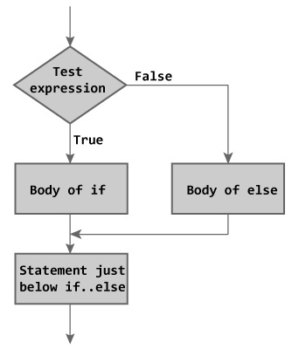
ELSE Statement Control
Sometimes computer programs require two alternative actions
Commands to be done when the if condition is false
Provides a second option
Allows a program to say:
"Do this otherwise do that"
Note the Syntax:
Lowercase else
Ending colon :
Indented code block
Sample Program:
classSize = int(input("How many students:"))
if (classSize > 30) :
extra = classSize - 30
print("You need %d more computers" % extra)
else :
print("Your computers are ok")
print("Let's start our lesson")

Slide 31
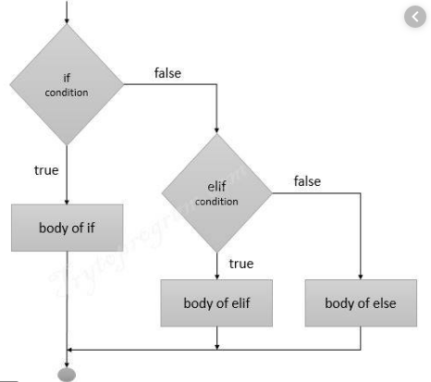
ELIF Statement Control
Sometimes computer programs require many alternative actions
Each elif has its own condition
Conditions are checked in order
Code is executed for the first one that is true
Only the first true condition is executed, even if next conditions are also true
Note the Syntax:
Lowercase elif
Its own conditional expression
Ending colon :
Indented code block
Sample Program:
classSize = int(input("How many students:"))
if (classSize > 30) :
extra = classSize - 30
print("You need %d more computers" % extra)
elif (classSize < 14) :
print("You need more students")
else :
print("Let's start our lesson")

Slide 32
Program Comments
Sometimes complicated parts of a program need to be explained with words
These words are not part of the program code and do not have to follow Python Syntax
These comments are helpful for understanding the program by you or someone else in the future
Line Comments
Begin with a #
everything after the # is a comment
Used to explain a specific line of code
Block Comments
Begin and end with """ or ''' (Three quotations)
Can span multiple lines
Used to explain large blocks or sections of code
Sample Program:
classSize = int(input("How many students:"))
"""
This nested if statement looks at the class size
to determine if things are properly set up.
"""
if (classSize > 30) :
# Normal class size is 30 students, extra is over 30
extra = classSize - 30
print("You need %d more computers" % extra)
elif (classSize < 14) :
print("You need more students")
else :
print("Let's start our lesson")

Slide 33
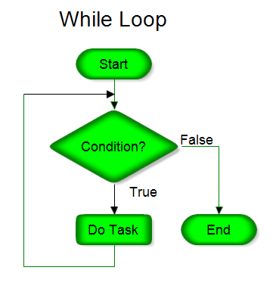
Conditional Loops
Sometimes programs need to repeat a block of instructions over and over again
Repeat a certain number of times
Repeat while a condition is true
Do not use "cut-and-paste" to make copies of your code
It is too much work
It makes your program difficult to understand and debug
You may not know in advance how many copies you need
Use a Python Loop!

Slide 34
While Loop
A while loop can be used to repeat a block of code
The loop continues as long as the condition is true
The condition is checked each repeat of the loop
The code block is executed each repeat of the loop
The loop exits when the condition becomes false
Note the Syntax:
Lowercase while
Its own conditional expression
Ending colon :
Indented code block
Sample Program:
print(" ")
print("This program uses a countdown loop")
print(" ")
startCount = int(input("Enter a number:"))
"""
This loop counts down to zero
"""
currentCount = startCount
while (currentCount >= 0) :
print("Count = %d" % currentCount)
currentCount = currentCount - 1
#Countdown Completed!
print("Blastoff!!!!")

Slide 35
Infinite Loop – Logic Error
Sometimes the loop condition never becomes false
In this case the loop never exits and repeats forever
This is called an Infinite Loop
The sample program contains an error in the loop condition.
(Variable startCount is used instead of CurrentCount)
Infinite loops are one result of Logic Errors
A Logic Error:
Error not because of a typo (Syntax)
Error not because of an undefined variable (Run Time)
Error due to poor thinking or design of your computer code
Sample Program:
print(" ")
print("This program uses a countdown loop")
print(" ")
startCount = int(input("Enter a number:"))
"""
This loop counts down to zero
"""
currentCount = startCount
while (startCount >= 0) :
print("Count = %d" % currentCount)
currentCount = currentCount - 1
#Countdown Completed!
print("Blastoff!!!!")

Slide 36
Student Questions
Notes and Template Code

Slide 37
Generating A Random Number
# This code generates a random number between 0 to 9
# Stores the value of the random number in the variable "targetNumber"
# Then prints out the result
import random
targetNumber = random.randint(0,9)
print("The random number %d is the target." % targetNumber)

Slide 38
Student Questions – Guessing Game
Create a game to guess a random number
Basic Game
Guess the number
Medium Game
Guess the number with clues
Enhanced Game
Guess the number with clues and Looping

Slide 39
End of Lesson B.3

Slide 40
Use Of Comments For Debugging

Slide 41
Use Of Print For Debugging

Slide 42
Counted Loop

Slide 43
Breaking A Loop Early

